Slide 1
loop constructs
Module 4

Slide 2
Content
Loops
while loops
do/while loops
For loops
Label statement
Using break and continue
Facts about the quiz

Slide 3
loops
Set of instructions or operations while a condition is true
Java has 3 ways of executions of loops
while
do while
for loop

Slide 4
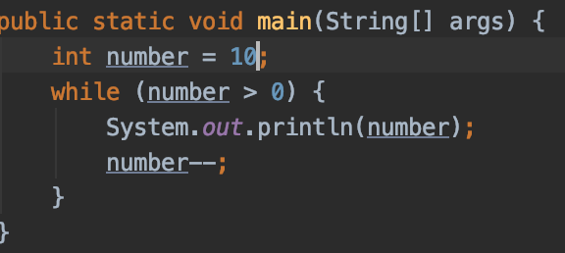




while
while (contidion) {
//statements;
}
If true
True block
start
Condition block
If false

Slide 5
While
Allows code to be executed repeatedly based on a given Boolean condition
Starts with the checking of condition
If it evaluated as true – then executes the body statement
If it evaluated as false – then terminates the while loop
While loops is useful especially for cases when we don’t know at the time of writing the program who many iterations will have (for example dynamic length of an array or collection)

Slide 6
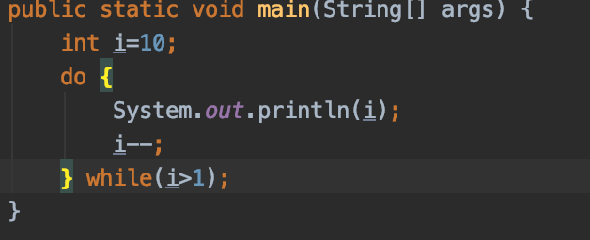




Do while
do {
//statements;
} while (condition)
If true
Condition statement
start
Statement
If false

Slide 7
Do while
Executes the statement first and then checks for the condition
At least one time the do-while block statement will be executed
Terminates when the condition is false

Slide 8
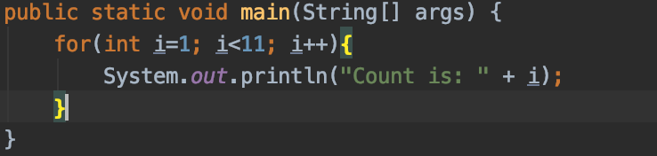










For loop
start
initialization
for(initialization; condition ; increment/decrement) {
statement(s);
}
condition
Incr/decr
statements
end

Slide 9
For loop
Defines by 3 parts
the initialization statement (int i = 1 in our example)
testing condition (i<11; in our example)
an increment or decrement part for incrementing/decrementing the control variable (i++; in our example)
The initializing statement marks the beginning of the loop structure
Executed only once
if a particular variable is declared within this part, then the scope of the variable remains limited within the loop

Slide 10
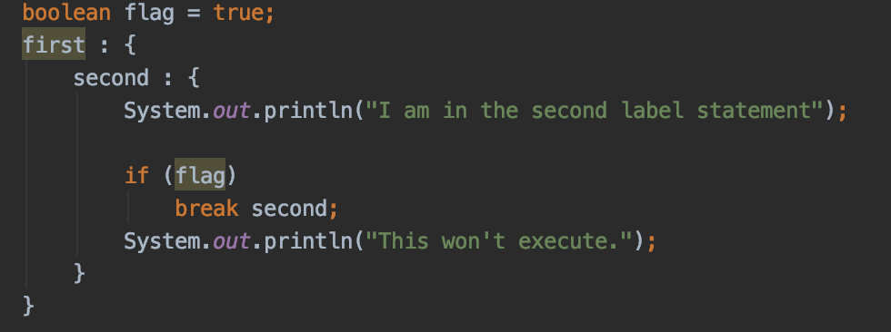
Label statement
A Label is used to identifies a block of code.
Syntax:
label: {
statement1;
statement2;
statement3;
. . }

Slide 11
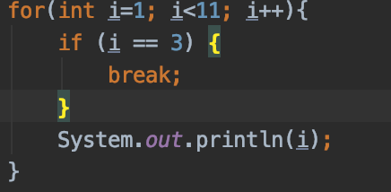
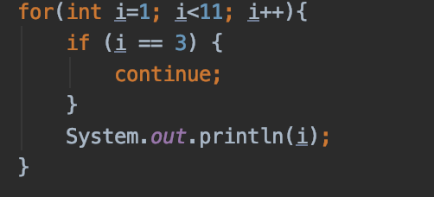
Using break and continue
1 ,2 ,
1 ,2 ,4 ,5 ,6 ,7 ,8 ,9 ,10 ,

Slide 12
Using break and continue
Break
is a loop control statement which is used to terminate the loop
As soon as the break statement is encountered from within a loop, the loop iterations stops there and control returns from the loop immediately to the first statement after the loop
Terminate a sequence in a switch statement as well (as we already know)
Continue
when a continue statement is encountered the control directly jumps to the beginning of the loop for the next iteration instead of executing the statements of the current iteration
Used when we want to skip a particular condition and continue the rest execution
Used for all types of loops – while, do-while, loops

Slide 13
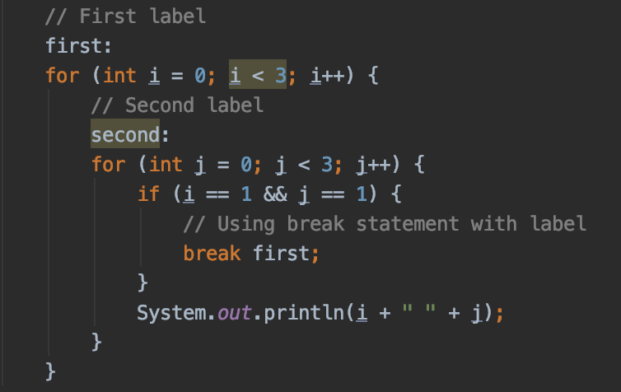
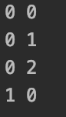
Using break and continue
Once I and J reaches 1, we do stop first iteration and so - the second as well is stopped

Slide 14
Flow control usage
 | Allow optional label | Allows break statement | Allows continue statement
if | Yes | No | No
while | Yes | Yes | Yes
do while | Yes | Yes | Yes
for | Yes | Yes | Yes
switch | Yes | Yes | No

Slide 15
Demo
Java_module_4 -> java_loops_demos -> LoopsContainer

Slide 16
Exercise
Java_module_4 -> exercises folder

Slide 17
Facts about the quiz
Understand loop statements.
A syntaxis knowledge and structure of all loops, while, do-while, and for loops and for each.
Each loop has its own special properties and structure
Also, be familiar with the enhanced for-each loops that iterate over lists.
Know how the break and continue key words works
Know which statement accepts break and which continue key word
Know how break and continue statements works inside embedded loops or switch commands

Slide 18
Facts about the quiz
Four kind of loops
The while loop
while (expression)
statement_or_block
The do-while loop
do
statement_or_block
while (expression);
The for loop
The for-each loop (enhanced for)

Slide 19
Facts about the quiz
For loop
Syntax:
for ([initialization_expr]; [termination_expr]; [increment_expr])
statement_or_block
All 3 expressions are optional:
// infinite loop example
for ( ; ; ) { }

Slide 20
Facts about the quiz
For loop
Syntax:
for (type element : collection)
statement_or_block
final is the only allowed modifier for element
while (false) { … } is compilation error
do { … } while (false); code is executed only once
for (…; false; …) { … } compilation error

Slide 21
Facts about the quiz
Breaking Loops
There are two kinds of breaks for a loop:
The unlabeled break: break;
The labeled break: break label;
unlabelled break is:
It terminates the switch, for, while, or do-while
labelled statement (any, not only loops)
The control flow is transferred to the statement immediately following the labelled (terminated) statement or block
It’s valid only within the block of code under the scope of the label

Slide 22
Facts about the quiz
// Example 1: break a lable1
lable1 : {
// … code here
break lable1;
// … more code here
}
next_statement_after_break;
// Example 2: break nested statements
label2:
for (i = 0; i < 9; i++) {
for (j = 0; j < 9; j++) {
if (i == j) {
break label2;
}
}
}
next_statement_after_break;

Slide 23
Facts about the quiz
Continuing Loops
unlabelled continue: continue;
labelled continue: continue label;
For the unlabelled continue:
- It skips the current iteration of a for, while, or do-while loop
- You get a compile-time error if either:
No for, while or do statement encloses the continue The continue target (label) is not a for, while or do

Slide 24
Questions?
Notes:
Do you have any questions?

Slide 25
Thank You For Your Time

